Slide 1
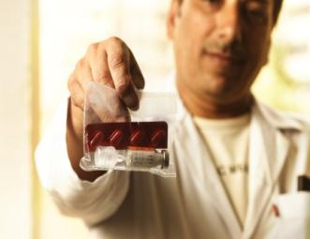
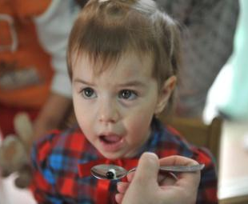
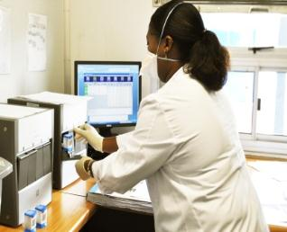
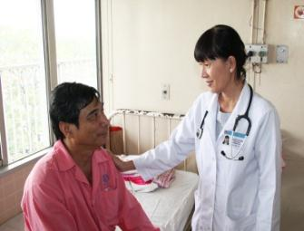
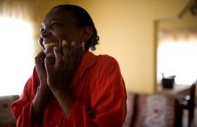




Tuberculosis in 2016
Burden, challenges, innovations
Dr Mario RAVIGLIONE
Director
Nuffield Lecture Theatre
Liverpool, UK, 26 October 2016

Slide 2
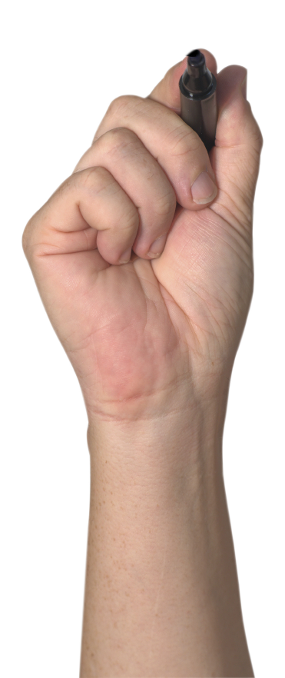



Overview
TB as a global health challenge
Response: End TB Strategy in the era of the Sustainable Development Goals
Innovations are key

Slide 3
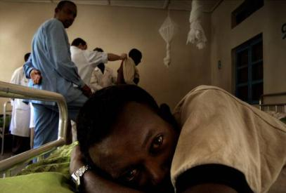
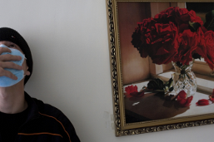


Tuberculosis: basics
Tuberculosis (TB) is one of the oldest diseases of humans
TB is caused by Mycobacterium tuberculosis
TB usually affects the lungs, although other organs are involved in 15-30% of cases
If properly treated, TB caused by drug-susceptible strains is curable in virtually all cases
If untreated, TB may be fatal within 5 years in 2/3 of cases
MDR-TB is a form of TB that needs longer, more toxic and more expensive regimens. Cure rate is 50%
One third of world is estimated to have latent TB infection

Slide 4





TB is airborne
Text
TB is transmitted via aerosolized particles from an infectious patient to those sharing the same air
Of those exposed, some (e.g., 10-15 in 1 year)
will get infected (1/3 of humanity!) and of those
Infected up to 10% will develop TB

Slide 5
Etiologic Epidemiology of tuberculosis
Largely endogenous
Innate resistance
Performance of cell-mediated immunity
Smoking….
Re-infection
Strain virulence
Largely exogenous
Particles/volume x exposure time
Production of infectious droplets
Clearance of air
Extent of exposure
Virulence of strain
Risk
Factors
Risk
Factors
Risk
Factors
Risk
Factors
Infectious
Tuberculosis
Sub-clinical
Infection
Exposure
Death
Non-infectious
Tuberculosis
1.8 M / yr
2 billion +
10.4 M / yr

Slide 6
Etiologic Epidemiology of tuberculosis
Medical conditions increasing risk:
HIV
Fibrotic lesions
DM
Silicosis
Steroids, TNF-inhibitors
Neoplasms, Chroni Renal Failure
Jejuno-Ileal Bypass, Gastrectomy
Malabsorption
Smoking
Alcohol abuse
Largely endogenous
Innate resistance
Performance of cell-mediated immunity
Smoking….
Re-infection
Strain virulence
Risk
Factors
Risk
Factors
Infectious
Tuberculosis
Sub-clinical
Infection
Exposure
Death
Non-infectious
Tuberculosis
1.8 M / yr
2 billion+
10.4 M / yr

Slide 7

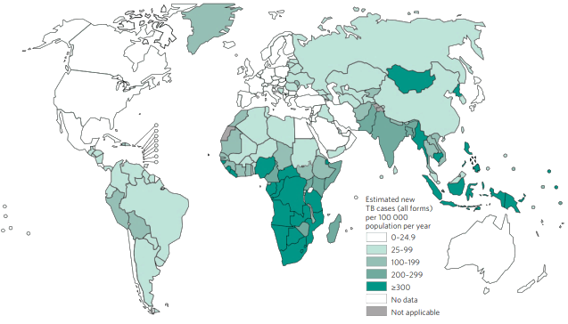


The Global Burden of TB, 2015
Estimated number
of cases
Estimated number
of deaths
10.4 million
142 per 100,000
  1 million children
  3.5 million women
  5.9 million men
1.8 million*
210,000 in children
500,000 in women
1,100,000 in men
All forms of TB
HIV-associated TB
1.2 million (11%)
390,000
Multidrug-resistant TB
MDR/RR
480,000
580,000
190,000
Source: WHO Global TB Report 2016 * Including deaths attributed to HIV/TB

Slide 8
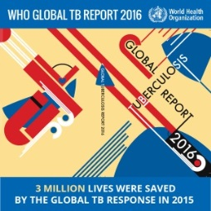
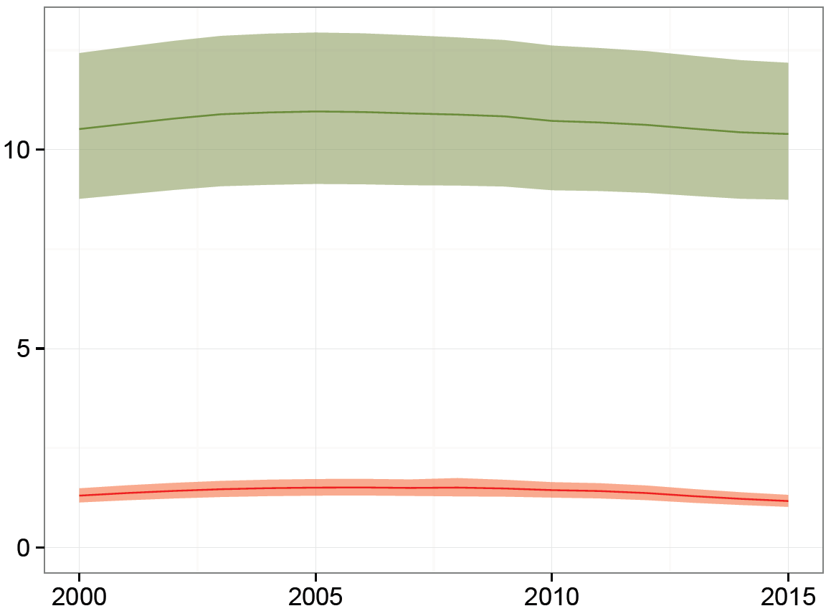
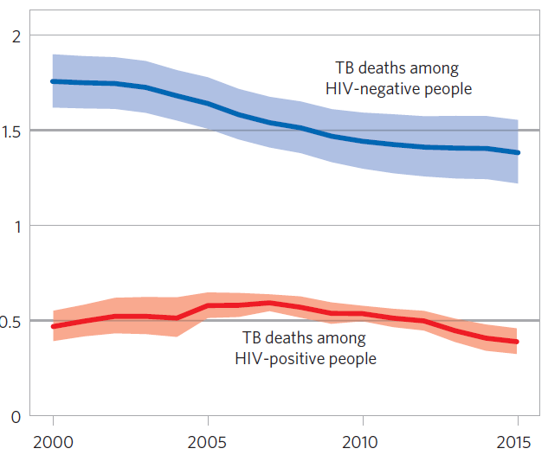
TB burden in 2015 larger than previously estimated thanks to revised estimates for India
TB incidence
TB deaths
2
Total
10.4
HIV-negative
Millions
10
1.5
1.4
5
1
HIV-positive (11% in 2015)
1.2
0.5
HIV-positive
0.4
0
0
2000 2005 2010 2015
2000 2005 2010 2015
Accumulating evidence from survey and surveillance data

Slide 9

TB one of top 10 causes of death worldwide, ranks now above HIV
Ischaemic
heart disease
Stroke
Lower resp.
infections
COPD
TB
TB
Cancer: tracheal, bronchus, lung
HIV/AIDS
Diarrheal
diseases
0 0.5 1 1.5
Diabetes
Millions in 2015
HIV/AIDS
Road injuries
Deaths from TB among HIV-positive people
0 1 2 3 4 5 6 7 8
Millions in 2012

Slide 10


TB incidence: countries and regions
27% in India
9-10% each: Indonesia & China
5-6% each: Nigeria & Pakistan
Notes:
Try to mark 5 tops

Slide 11
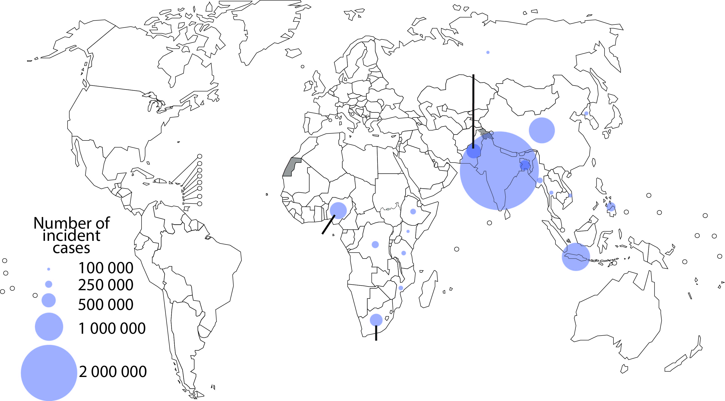
TB burden 2015
6 countries = 60% of cases
Pakistan
China
India
Number of incident cases
Nigeria
100 000
Indonesia
250 000
500 000
1 000 000
South Africa
2 000 000
circles shown for countries with at least 100,000 cases per year

Slide 12
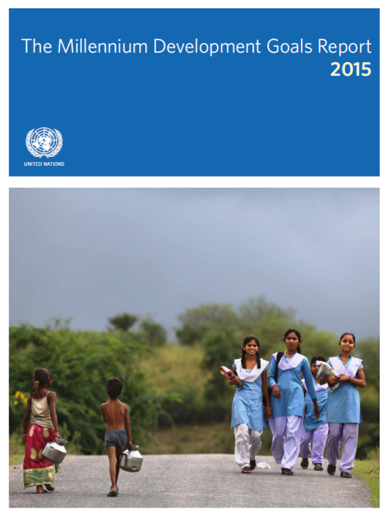

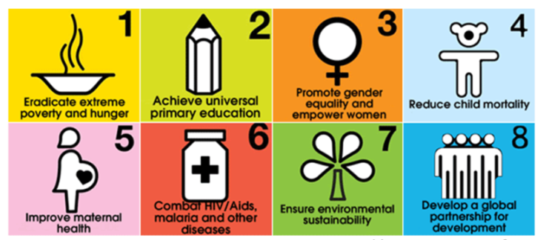
Millennium Development Goals 2015

Slide 13
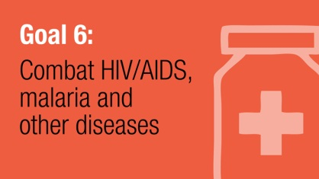

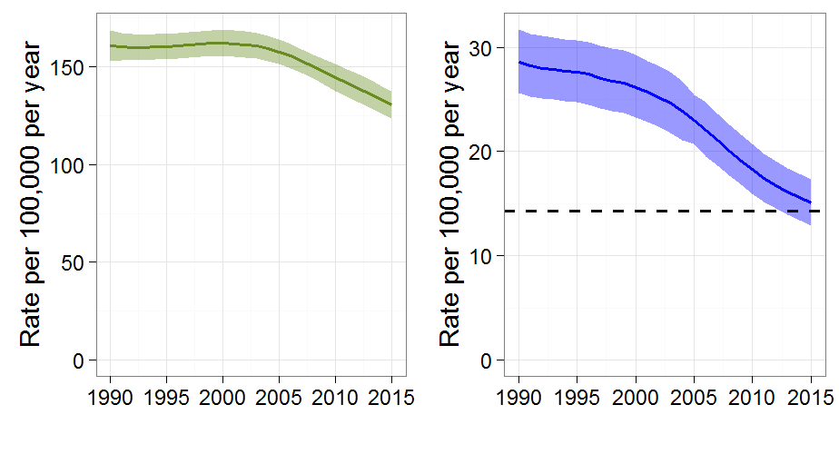
MDG6 TB target achieved
REVERSED
47% DROP IN TB MORTALITY
TB EPIDEMIC
Mortality
Incidence rate
Falling 1.4% per year (2000-2015).
18% drop since 2000
Target
49 million lives saved between 2000 and 2015
47% decline since 1990
But huge burden of deaths and suffering remains.
10.4 million people fell ill with TB in 2015, and there were 1.8 million deaths

Slide 14
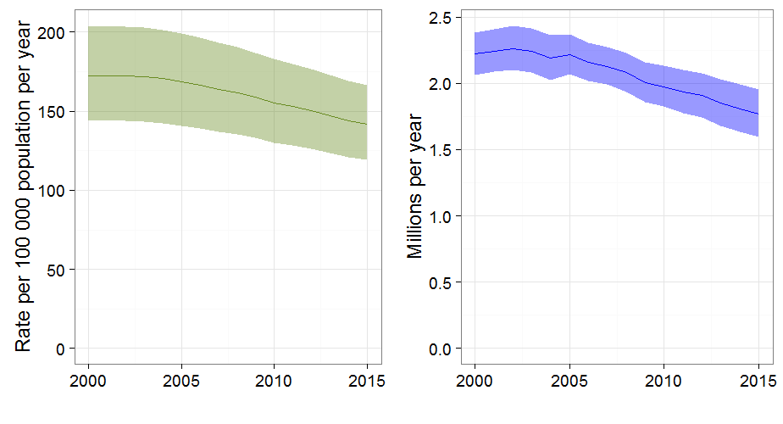
SDG3 – decline needs to accelerate
TB deaths (incl. HIV)
Incidence rate
Falling 1.4% per year (2000-2014).
18% drop since 2000
Falling 2.9% per year (2000-2014).
34% drop since 2000
49 million lives saved between 2000 and 2015
But huge burden of deaths and suffering remains.
10.4 million people fell ill with TB in 2015, and there were 1.8 million deaths

Slide 15
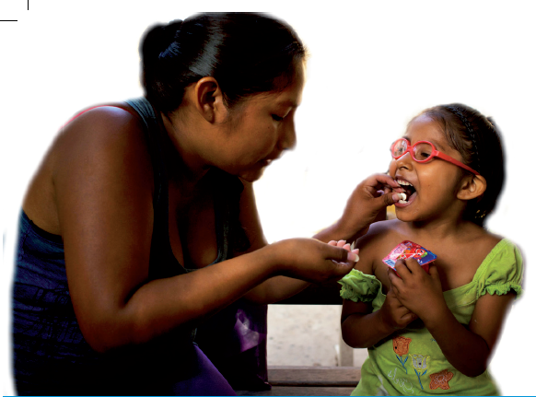
Challenges: Priorities for action 2016
PRIORITY ACTIONS TO END TB
REACH THE 3.6 MILLION MISSED CASES
ADDRESS THE MDR-TB CRISIS
ACCELERATE RESPONSE TO THE TB/HIV CO-EPIDEMIC
ELIMINATE CATASTROPHIC COSTS
INTENSIFY TB RESEARCH AND UPTAKE
CLOSE FINANCING GAPS

Slide 16
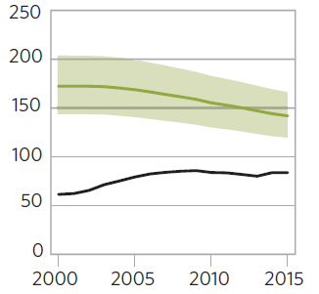
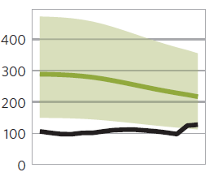
Case notifications increasing but large incidence/notification gap
Global
India
Rate per 100 000 population
250
200
400
150
300
4.3 million cases
100
200
50
100
+34%, 2013‒2015
0
0
2000 2005 2010 2015
2000 2005 2010 2015

Slide 17
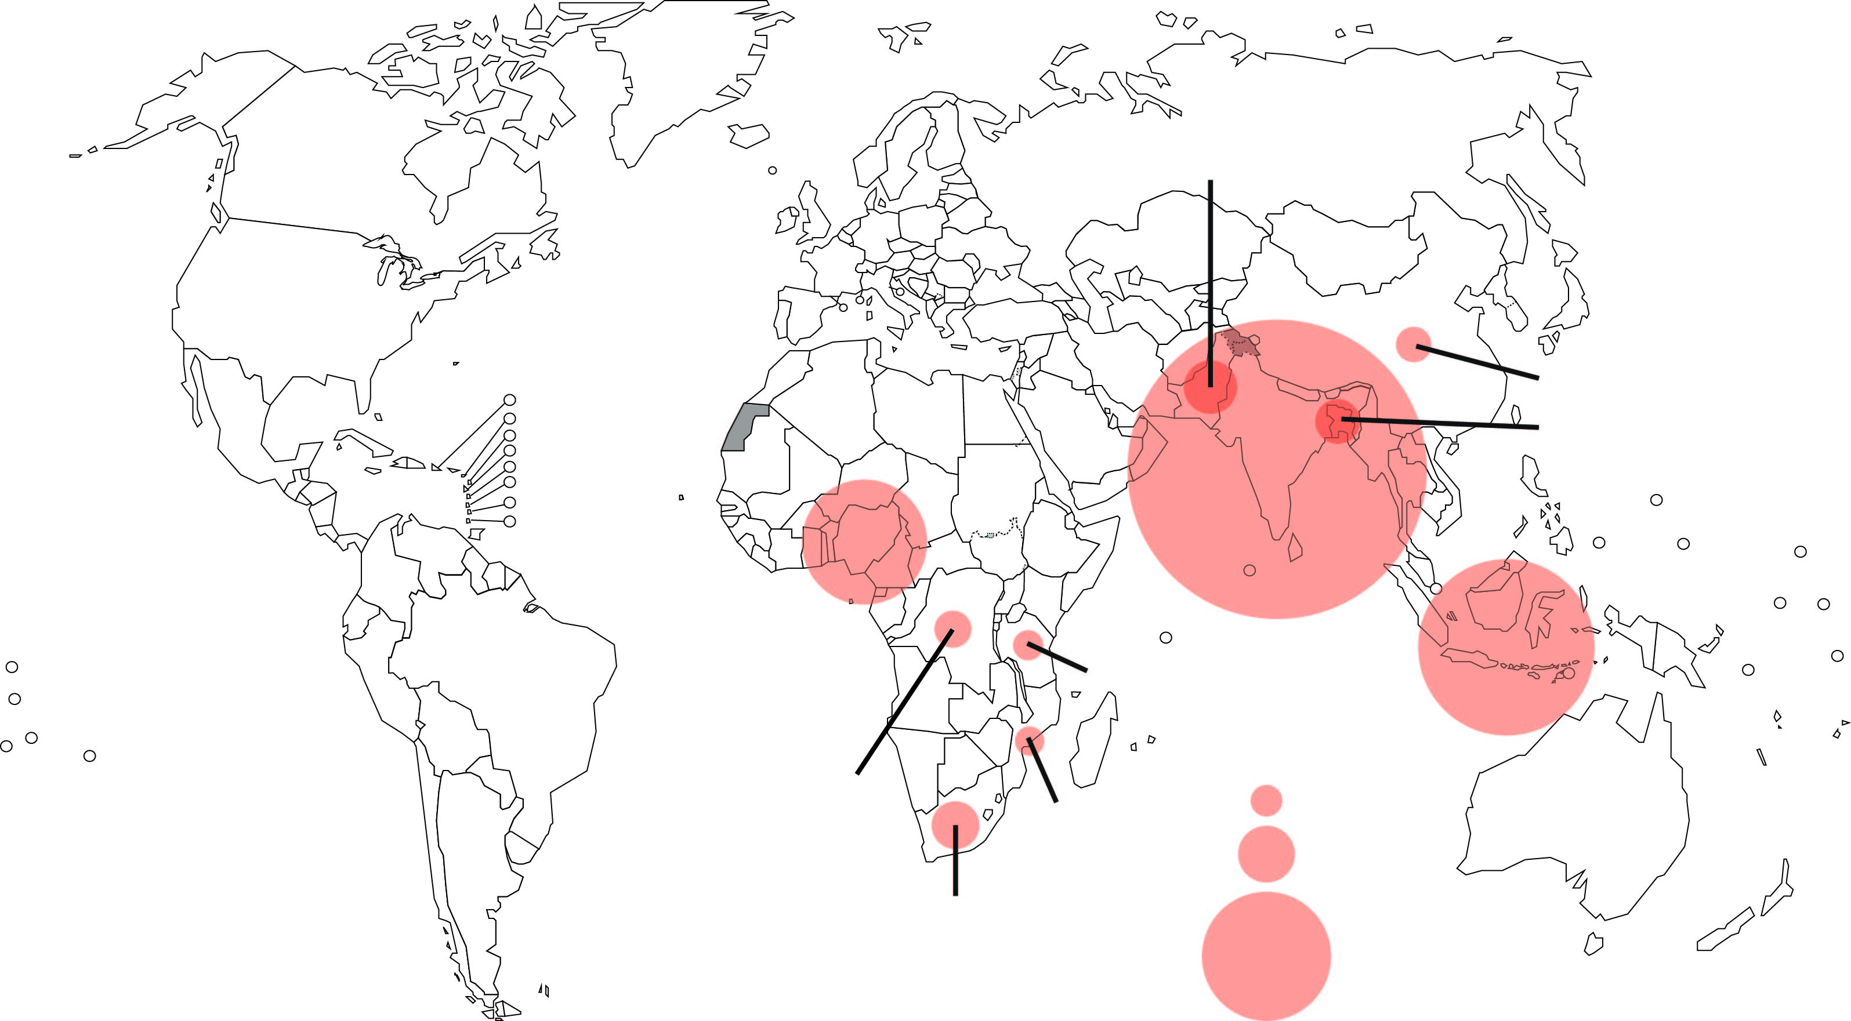
10 countries = 77% of the gap
3 countries almost 50%: India, Indonesia, Nigeria
Pakistan
China
Bangladesh
India
Nigeria
Tanzania
Indonesia
DR Congo
100 000
Mozambique
200 000
South Africa
500 000

Slide 18
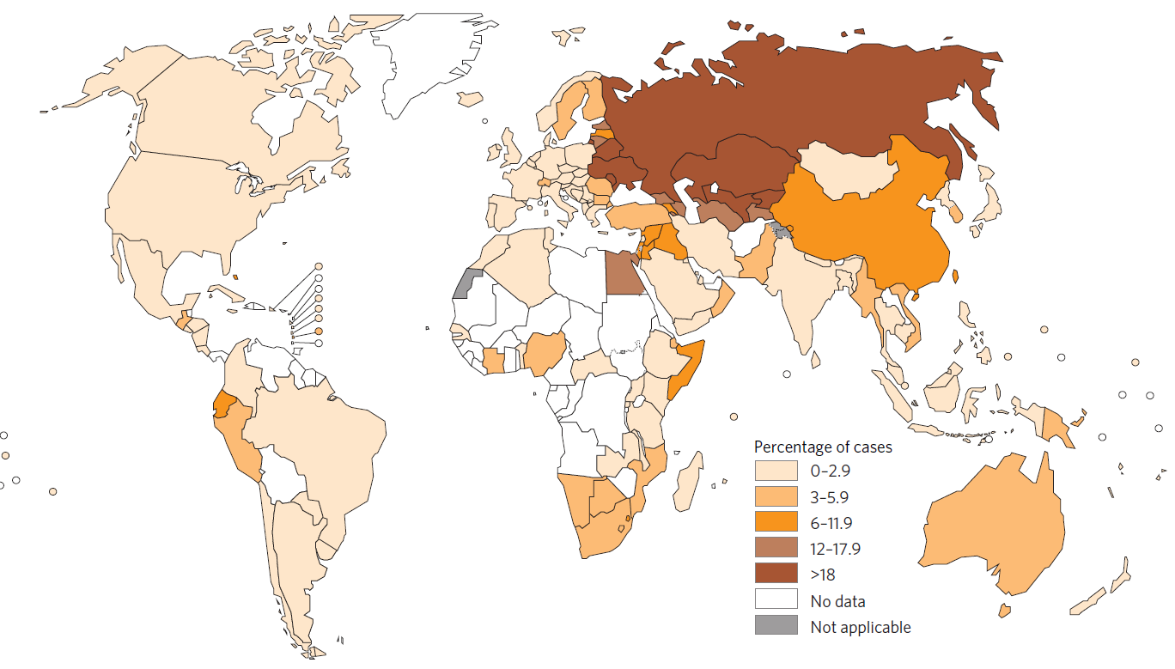
MDR-TB remains a crisis that is poorly addressed
Globally: 480,000 new cases of MDR-TB in 2015
Plus: 100,000 new cases of rifampicin-resistant TB eligible for MDR-TB treatment
% cases with MDR/RR-TB
0-2.9
3-5.9
6-11.9
12-17.9
>18

Slide 19
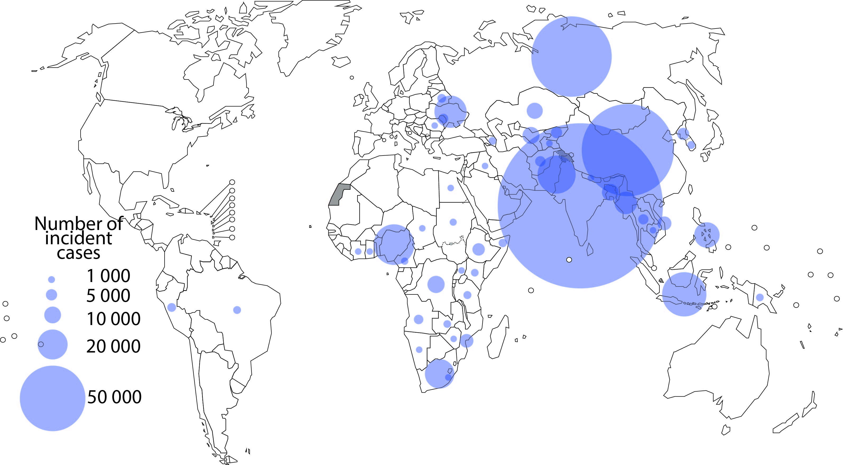
MDR/RR-TB: 3 countries, 45% cases
Russian Federation
China
India
Number of incident cases
1000
5000
10 000
20 000
50 000
circles shown for countries with at least 1000 cases per year

Slide 20
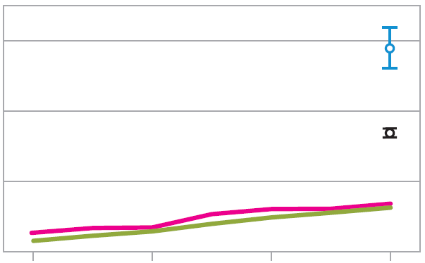
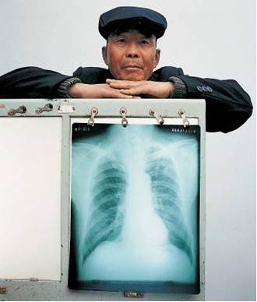
MDR-TB and RR-TB treatment enrolments increasing but large gaps persist
Number of cases globally
600,000
Incidence
TB
detection
400,000
MDR/RR-TB cases among notified TB patients
DST
200,000
Detected 132,000
Enrolled on treatment 125,000
0
2009 2011 2013 2015
And treatment success rate only 52% globally
Notes:
DST coverage in 2015 24% new, 53% previously treated, 30% overall

Slide 21
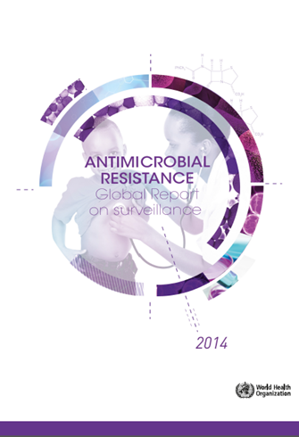
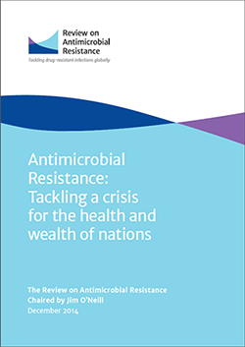
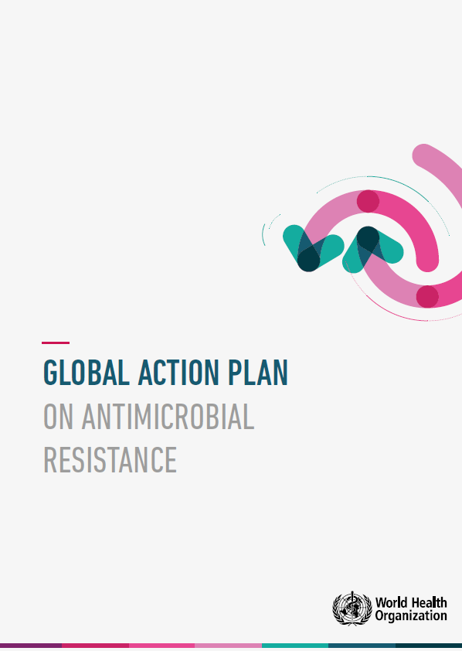
Tackling the AMR crisis
Increasingly serious global public health threat
  New evidence and information
    Untreatable infections
    25,000 deaths/yr across EU
  Desperation over "dry pipeline"
Economic impact
  by 2050, lead to 10 million deaths every year
  reduction of 2-3.5% in GDP
  cost more than US$1.5 billion every year in healthcare expenses and productivity losses
Growing awareness and commitment
  Political, professional, public
  Health, agriculture, finance/economic, industry
MDR-TB to be highlighted on the AMR agenda
Source: Dr Marcus Sprenger, WHO/HQ/HSE/HEA

Slide 22
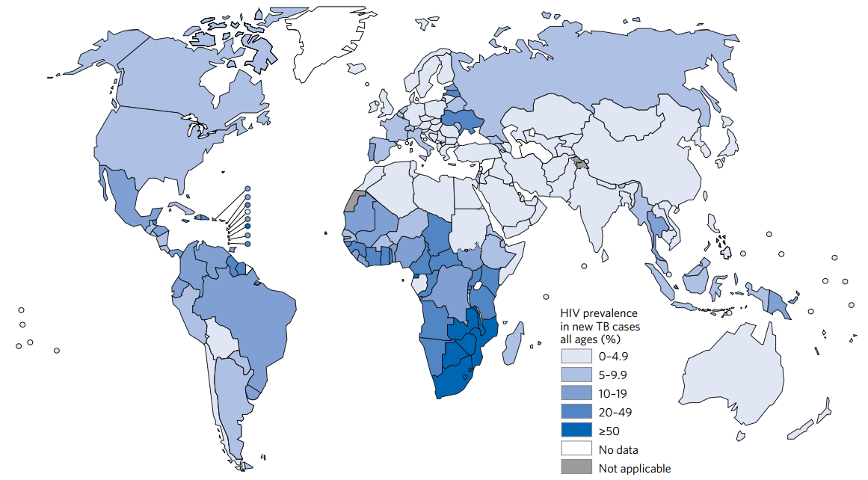
Accelerating response to TB/HIV
Estimated HIV prevalence in new TB cases, 2015
Ref: Global TB Control Report 2016
71% of TB/HIV cases in Africa
Other co-morbidities emerging in other regions

Slide 23
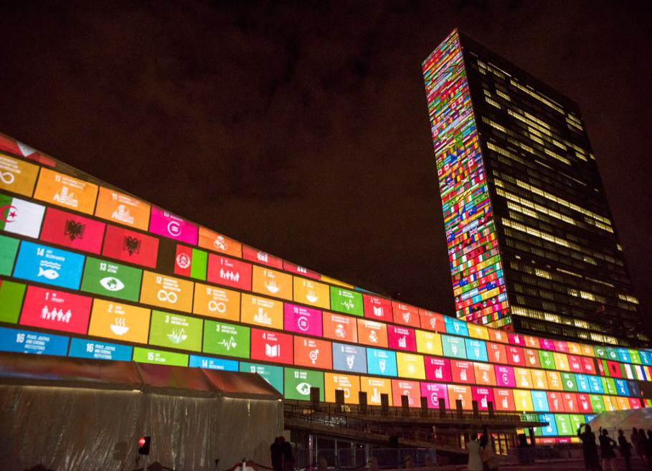


A new era with new ambitions
and a paradigm shift
UN Sustainable Development Goals: 2016 – 2030
17 goals and 169 targets

Slide 24

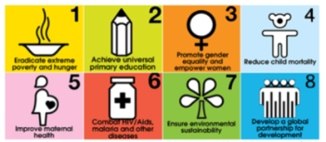
Transitioning from MDGs to SDGs
MDG era
SDG era
Developing country focus: poverty reduction, education, health, economics
8 goals, 21 targets
Aid-related financing
Focused, categorical
Current development expenditures: 200 billion US$/year
Universal: economic, social and environmental pillars of sustainable development
17 goals, 169 targets
Globally applicable, domestic and aid financing
"Integrated, indivisible", multidisciplinary, equity as focus
Expected future investments 2-3 trillion US$/year
People, Planet, Prosperity, Peace, Partnership

Slide 25









SDG 3 and its 13 targets by 2030
3.1 Reduce
Maternal
mortality
3.2 Reduce
child and
neonatal mortality
3.3 End the epidemics of AIDS, tuberculosis, malaria
& neglected tropical
diseases and combat
hepatitis, water-borne
and other communicable diseases
3.3 End the epidemics of AIDS, tuberculosis, malaria
& neglected tropical
diseases and combat
hepatitis, water-borne
and other communicable diseases
3.4 Reduce
mortality due to NCD and improve mental health
3.5 Strengthen
Prevention and treatment of substance abuse (narcotics, alcohol)
3.6 Reduce
Mortality
due to road traffic
injuries
3.7 Universal
access to sexual and
reproductive health-care services
3.8 Achieve
universal
health coverage
3.9 Reduce
deaths and illness
due to pollution
and contamination
3.a Strengthen implementation FCTC (tobacco)
3.b Access to affordable essential medicines and technologies
3.c Increased health financing and health workforce in developing countries
3.d Enhance capacity for early warning, risk reduction and management of national and global health risks

Slide 26




Moving from halting TB to ending TB by 2030
Global commitment to End TB
SDG Target 3.3 – BY 2030
end the TB epidemic

Slide 27
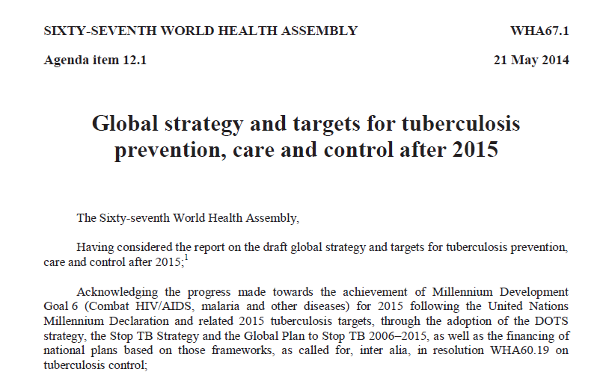

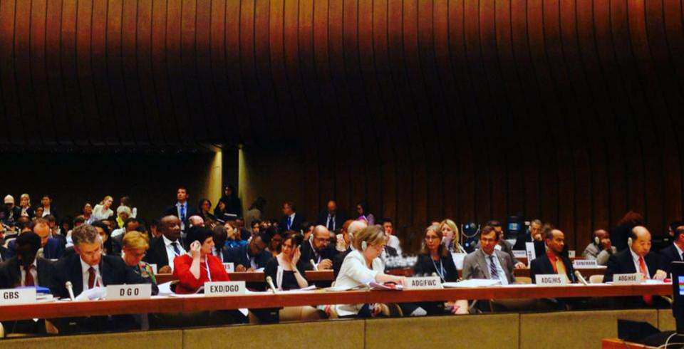
67th World Health Assembly, Geneva, May 2014

Slide 28
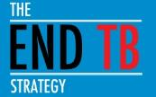
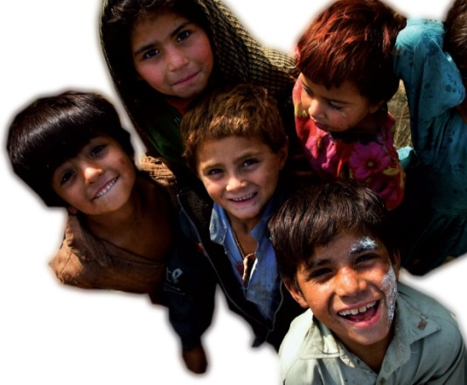
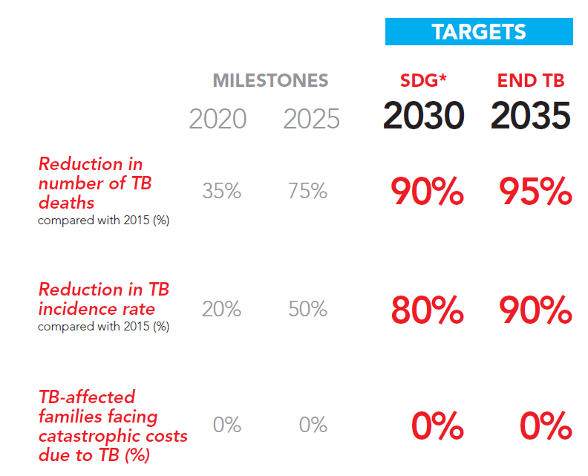
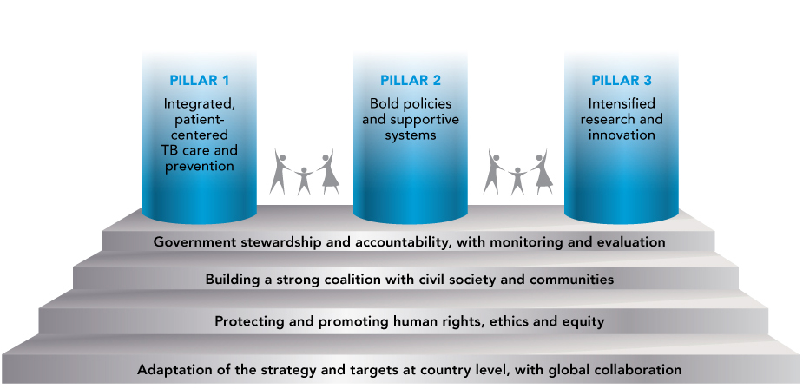
The End TB Strategy:
Vision, Targets and Pillars
Vision:
A world free of TB
Zero TB deaths, Zero TB disease, and Zero TB suffering
Goal:
End the Global TB epidemic

Slide 29
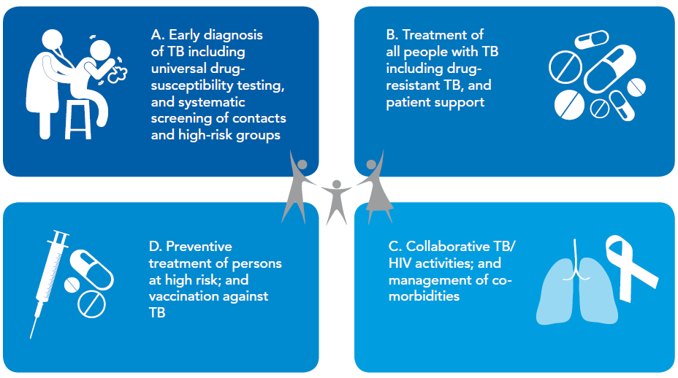
PILLAR 1: INTEGRATED, PATIENT-CENTRED CARE AND PREVENTION

Slide 30
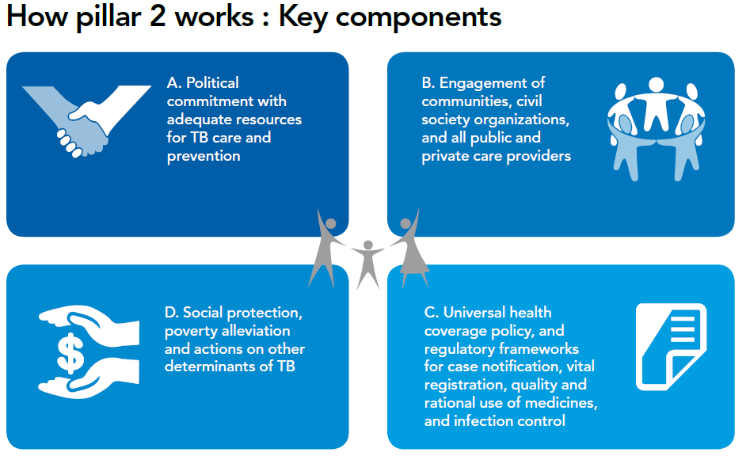
PILLAR 2: BOLD POLICIES AND SUPPORTIVE SYSTEMS

Slide 31
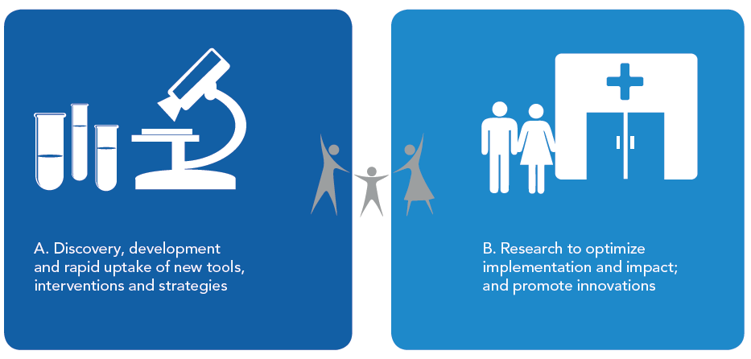
PILLAR 3: INTENSIFIED RESEARCH AND INNOVATION

Slide 32
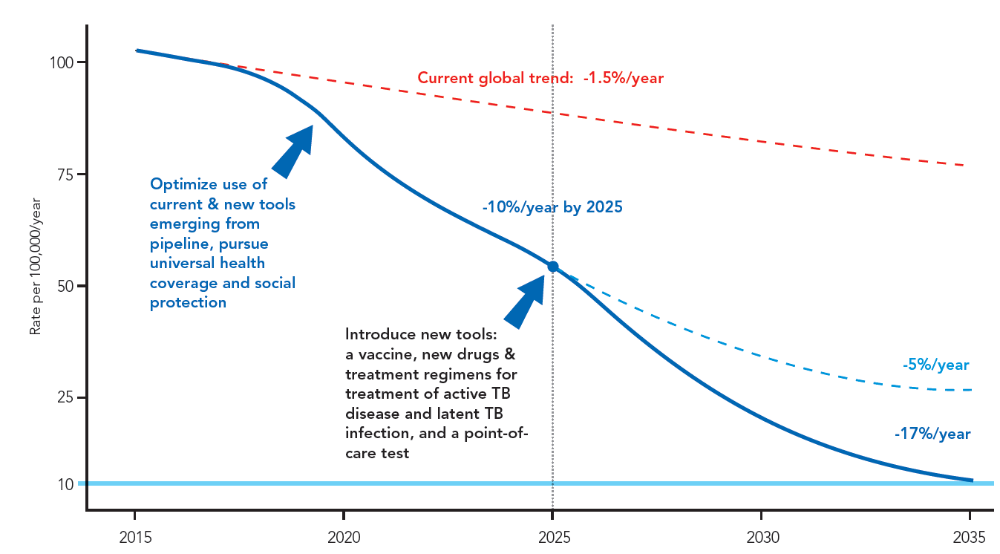
Innovations and Research are critical to break the trajectory of the TB epidemic
Better diagnostics, including new point-of care tests;
Safer, easier and shorter treatment regimens for disease and latent TB infection;
Effective pre- and post-exposure vaccines.
All technological and system innovations possible
Notes:
The 10% per year fall in incidence that is needed by 2025 has been previously achieved only within the wider context of UHC and broader social and economic development. UHC means providing all people with access to needed services of sufficient quality to be effective, without their use imposing financial hardship. Progress in the countries with the highest burden today, such as China, India, Indonesia, Nigeria and South Africa will strongly influence whether targets can be achieved or not. To lower cases to 10 per 100,0000 population by 2035 ("end the global TB epidemic") and achieve a 95% reduction in TB deaths by 2035 will need a technological breakthrough by 2025 that will allow an unprecedented acceleration in the rate at which TB incidence falls between 2025 and 2035. This will only happen with substantial investment in R&D in the years up to 2025, so that new tools such as a post-exposure vaccine or a short, efficacious and safe treatment for latent infection that could substantially lower the risk of developing TB among the approximately 2 billion people that are already infected, are developed.

Slide 33
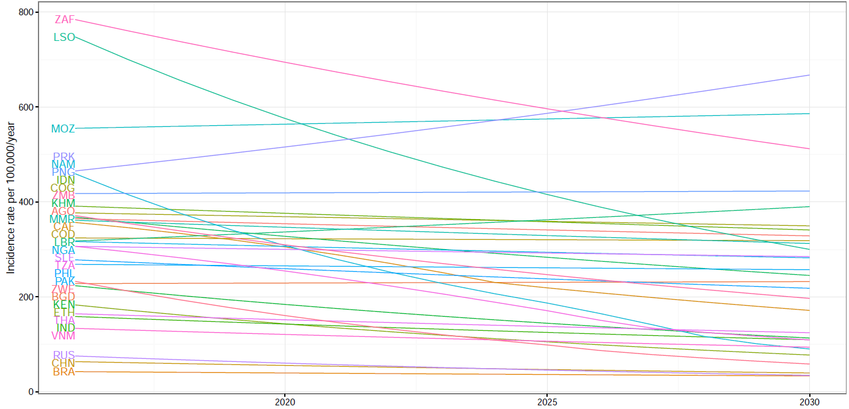
Reality check: Projected incidence based on current trends in 30 HBCs

Slide 34
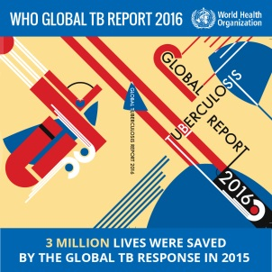

Critical funding gaps can compromise
efforts to save lives
IMPLEMENTATION – US$8.3 billion needed in 2016
(STBP Global Plan to Stop TB 2016-2020)
$1.7 billion
funding gap
RESEARCH –
at least US$ 2 billion per year needed
$621 available in 2015
$1.3 billion
funding gap
$8.3 billion funding required in 2016 for
TB prevention, diagnosis and treatment
TAG TB R&D report 2016

Slide 35
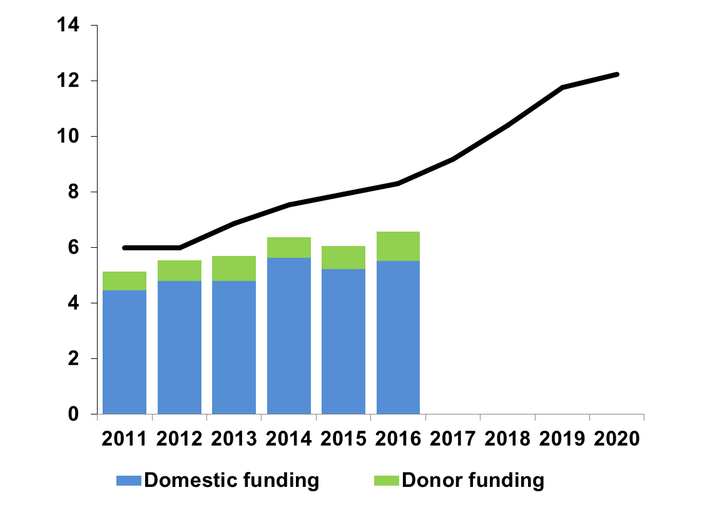
TB funding needs to increase
in low and middle-income countries
Stop TB Partnership Global Plan estimates of funding required
US$ billions
US$ 6 billion
US$ 2 billion
Domestic funding
International donor funding

Slide 36
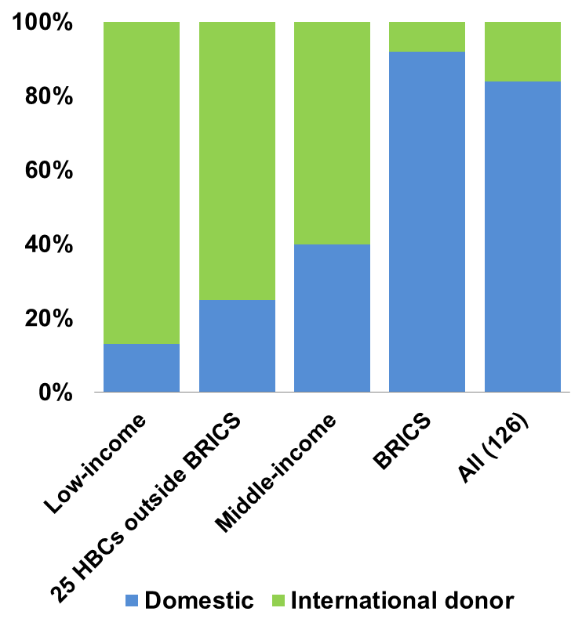
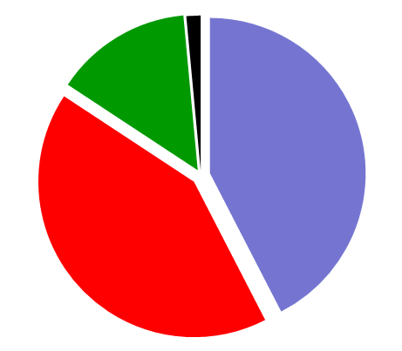
More domestic and international donor funding needed
Share of available funding in 2016
High-income (2%)
Low-income (14%)
BRICS
42%
Other middle-income (42%)
Share of global TB burden in 2015 (incident cases)

Slide 37
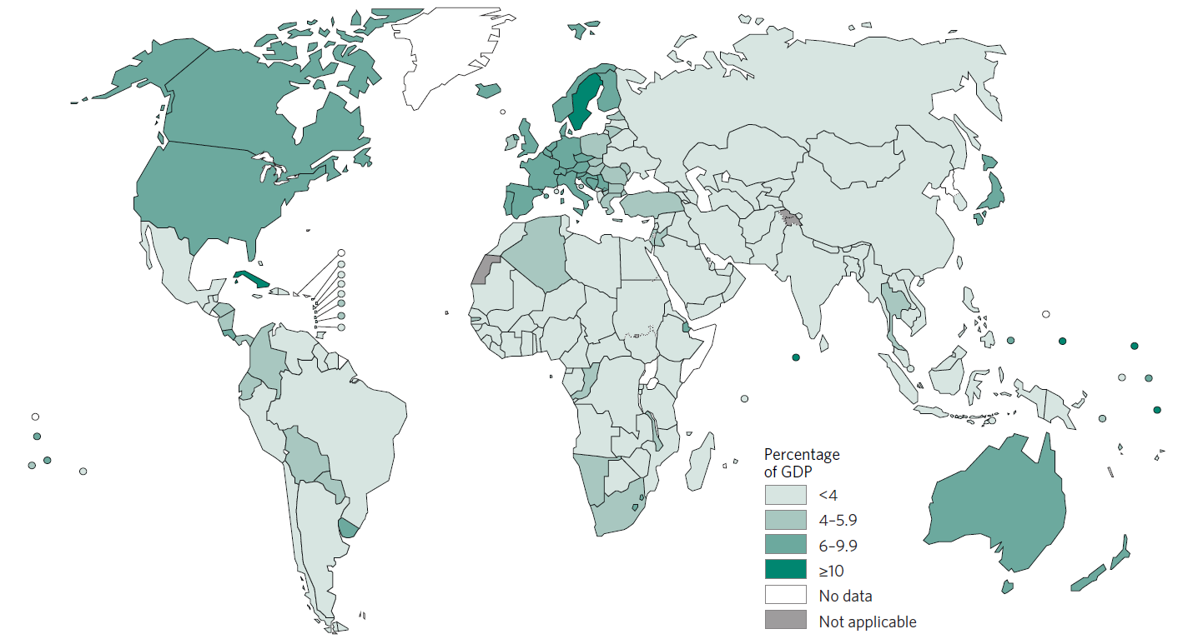
Overall health financing needs to increase
Gov’t health spending as % GDP
<4
4-5.9
6-9.9
≥10
Notes:
150 countries <6% GDP

Slide 38
International donor funding has grown for TB
But HIV and Malaria funding are 9x and 2x
$1.32 billion
funding gap
Source: Creditor reporting system. Paris: Organisation of Economic Co-operation and Development
Note: HIV funding is recorded as “STD control including HIV/AIDS”.
Notes:
Animation for this and subsequent slide are not like the rest of the presentation – needs to be fixed.

Slide 39
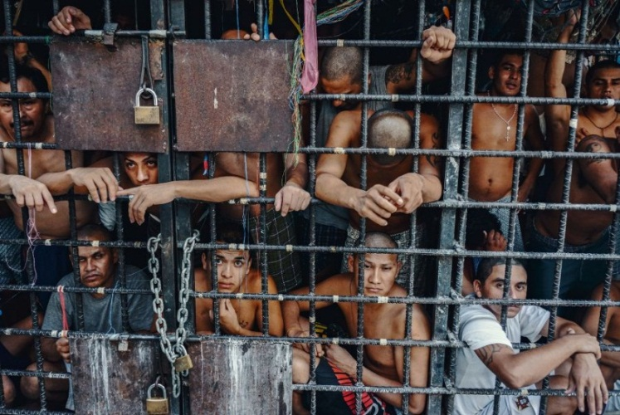
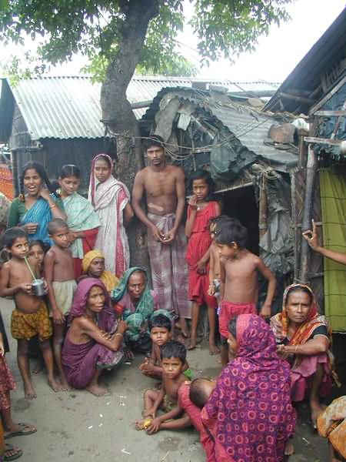



First of all, UHC and social protection for the poorest

Slide 40
Policy change towards
Universal Health Coverage
WHO definition: "Universal access to needed health services without financial hardship in paying for them". (WHR 2010).
Lack of health insurance and social risk protection inhibits access and use of health services
For those affected by TB, costs are high. For MDR/XDR-TB, the costs of care are catastrophic
Absence of UHC contributes to slow progress on the SDG for health, including reduction of TB incidence and mortality.
Notes:
However,
Even at maximum DOTS coverage, case detection seems to remain below the 70% target level in most settings (Dye et al 2002)
So we need innovative approaches to case detection.
The DEWG is a mechanism to do whatever it needs to be done
We need to ensure we make good use of it.
The 2nd ad hoc Committee produced some recommendations for action, the DEWG is a tool to facilitate/implement some of them.

Slide 41




Who carries the burden of tuberculosis?
…mostly, the most vulnerable
TB spreads in poor, crowded & poorly ventilated settings
Half a million women and 210,000 children died of TB in 2015; 10 million “TB” orphans
Migrants, prisoners, minorities, refugees face risks, discrimination & barriers to care
TB linked to HIV infection, malnutrition, alcohol, drug and tobacco use, diabetes

Slide 42
Composition of TB related costs, on average
UHC
Before treatment
50% of total costs
During treatment
50% of total costs
Source: Tanimura T, Jaramillo E, Weil D, Raviglione M, Lönnroth K. Financial burden for tuberculosis patients in low- and middle-income countries – a systematic review. ERJ 2014

Slide 43
Summary of catastrophic expenditure in
20 studies (10 Africa, 9 Asia, 1 EMR)
Range of average total cost (direct and indirect) of health seeking, diagnosis, treatment, and lost income for people registered in NTPs: 100-500$
This is on average 20-80% of individual annual income, and with a higher proportion for the poorer in the lower socio-economic levels
MDR/XDR-TB require lengthier diagnostic procedures, much more expensive drugs, prolonged treatment periods with more side effects…

Slide 44
Mean cost as percentage of yearly household per capita income

Slide 45
Poverty-disease trap
Undernutrition
Poor housing
HIV
NCDs and NCD risk factors (diabetes, smoking, alcohol, etc)
Poor health care access
Poverty
TB
High direct and indirect health care costs
Loss of employment and income
On average 50% of annual income lost!

Slide 46

GDP per capita predicts TB incidence
(2015 data)
Source: WHO, 2016

Slide 47
Weak and inequitable economic, social, and environmental policy
Globalisation, migration, urbanisation, demographic transition
Weak health system, poor access
Poverty, low SES, low education
Upstream determinants
Poor environmental protection
Unhealthy behaviour
Environment
Other diseases
Genetics
Active TB cases in community
Crowding Poor ventilation
Smoking, silica, air pollution
HIV, malnutrition, lung diseases, diabetes, alcohol, etc
Age, sex and genetic factors
Proximate risk factors
Contact with infectious droplets
Impaired host defence
Exposure
Infection
Active disease
Consequences
Source: Lönnroth et al. Drivers of tuberculosis epidemics: The role of risk factors and social determinants. Soc Sci Med 2009; 68 :2240–2246

Slide 48
Population attributable fraction:
Selected Risk Factors & Determinants
 | Relative risk for active TB disease | Weighted prevalence (22 HBCs) | Population Attributable Fraction in Adults
HIV infection | 20.6/26.7* | 1.1% | 19%
Malnutrition | 3.2** | 16.5% | 27%
Diabetes | 3.1 | 3.4% | 6%
Alcohol use (>40g / d) | 2.9 | 7.9% | 13%
Active smoking | 2.6 | 18.2% | 23%
Indoor Air Pollution | 1.5 | 71.1% | 26%
Sources: Lönnroth K, Raviglione M. Global Epidemiology of Tuberculosis: Prospects for Control. Semin Respir Crit Care Med 2008; 29: 481-491. *Updated data in GTR 2009. RR=26.7 used for countries with HIV <1%. **Updated data from Lönnroth et al. A consistent log-linear relationship between tuberculosis incidence and body-mass index.

Slide 49






Intensive investments in research to develop new tools
DIAGNOSTIC
VACCINE
TREATMENT
Sputum smear microscopy
Discovered 1882
BCG
Developed 1920s
1st-line TB drugs Discovered 1943-1970

Slide 50




RESEARCH AND DEVELOPMENT
Which new tools in the horizon in 2016?
PILLAR 3
Diagnostics:
9 new diagnostics endorsed by WHO since 2007;
Several in development including whole genome sequencing on sputum;
By 2020: rapid & sensitive PoC test, triage test, predictive LTBI test, rapid DST
Drugs and regimens:
2 new drugs and a 9-month regimen for MDR-TB endorsed since 2012;
A shorter 12-w regimen for LTBI;
By 2020: 4-m regimens for DS-TB, 6/9-m regimens for MDR-TB, and other new drugs
Vaccines:
1 vaccine with no detectable efficacy in 2013
15 vaccines in various phases of clinical trials, but unlikely available before 2020

Slide 51



New diagnostic pipeline 2016

Slide 52



In 2016, the best rapid diagnostic we have is
Xpert MTB/RIF – and now also SLD LPAs…

Slide 53


Global TB Drug Pipeline 2016 ¹

Slide 54




Rational introduction of new drugs against MDR-TB

Slide 55


Recommendations for MDR-TB treatment, 2016
Shorter regimen
Duration: 9-12 months; all for 4-6 months; 5-month continuation with 1, 4, 5, 6
Condition: no known or suspected FQ and/or injectable resistance
A fluoroquinolone of the latest generation (moxi-, levo-, gatifloxacin)
An injectable agent (aminoglycoside: kanamycin, amikacin; or polypeptide: capreomycin) for up to 6 months
Ethionamide
Clofazimine
Pyrazinamide
Ethambutol
High-dose isoniazid

Slide 56

The global vaccine pipeline, 2016

Slide 57




What research is required to end and eliminate TB ?
Fundamental science
Translational studies
Preclinical studies
Clinical studies/trials
Deployment and scale up of operational research
A radical intensification of efforts is needed along the full spectrum of research by:
Basic science (immunology, pathogenesis) to prompt discovery of new tools
R&D pipeline for testing and validating new tools
Innovative strategic approaches adapted to specific country needs.
Factors influencing health-related practices of patients and health care workers.
Social determinants of health and financial protection

Slide 58


Global Action Framework on TB research
Two main objectives:
① To promote, enhance and intensify TB research and innovation at country level
② To promote, enhance and catalyze TB research at global level
Fundamental step is that of pursuing, in all countries, national strategies, plans and networks
SPECTRUM OF TB RESEARCH
Source: Dr Marcus Sprenger, WHO/HQ/HSE/HEA

Slide 59




Looking ahead…
We need innovations
Precision medicine
Genomics
Big data
Digital technologies
Internet of Things
Game changing tools for large-scale social impact
Research
'The committee has decided to ban further research until it can be proven that your 'wheel' poses no threat to the environment, society or public health.'

Slide 60
Precision medicine to “precision public health”
Precision medicine is an approach for disease treatment and prevention that takes into account individual variability in genes, environment, and lifestyle for each person (NIH-USA).
Precision medicine tailors care to the characteristics of each person with the goal of improving outcomes.
How can we transition from overly standardised approaches towards precision medicine and yet be able to reach every person affected by a major public health threat like TB?
We need to take precision medicine to scale and make «precision public health» a reality.

Slide 61


Genomics for precision medicine

Slide 62

The power of Big Data for public health
“Big Data” refers to volumes of large, complex, linkable information, and includes medical, genetic, environmental, financial, geographic, and social media information.
Big data can be used to:
Provide insights into causes and outcomes of disease, better drug targets for precision treatment, and enhanced disease prediction
Improve understanding of health behaviors
Increase public awareness

Slide 63


Digital revolution: Internet of Things (loT)
The Internet of Things (loT) is the network of physical objects or "things" embedded with electronics, software, sensors, and network connectivity, which enables these objects to collect and exchange data.

Slide 64





NO!
IT IS happening now!
DO YOU THINK
THIS IS THE FUTURE?

Slide 65










Internet of Things for TB
Current Connected Diagnostic Platforms
PILLAR 1
Qiagen ESEQuant LR3 Rapid Speciation and LPA test reader
GeneXpert
Omni
BD BACTEC MGIT
Hain GenoScan LPA test reader
FIO Deki
Reader
Cepheid
Diagnostics Devices - Multiple Manufacturers – Multiple Assays
Alere
Others in test & development
PIMA
Alere-q
Source: Dr C. Denkinger, FIND

Slide 66









Precision in TB diagnosis and treatment
PILLAR 1
TREATMENT FOR DRUG SUSCEPTIBLE TB: 6HRZE or NEW Rx (?BNiMZ)
STANDARDIZED SHORTER
MDR-TB REGIMEN
4-6 Km-M-Pto-Cfz-Z-Hhd-E / 5 M-Cfz-Z-E
or NEW Rx (?BNiMZ)
DIAGNOSIS
NEGATIVE
NEGATIVE (MDR-TB)
POSITIVE
RESISTANCE TO
FLUOROQUINOLONES
A/O INJECTABLES
R-RESISTANT TB
First-line Rapid diagnostic
Xpert MTB/RIF
Second-line Line Probe Assay
POSITIVE (pre- or XDR-TB
TAILORED MDR-TB REGIMENS
OR NEW REGIMENS (?BPaL)

Slide 67



PILLAR 1
Whole genome sequencing in 3 years
Results from sputum samples in less than 48 hours
Accurate sequencing of M.tuberculosis
genome directly from uncultured sputa.
Identification of resistance mutations offers the prospect for rational rather than empirical treatment of MDR-TB

Slide 68





Precision in TB preventive therapy
PILLAR 1
ISONIAZID PREVENTIVE
THERAPY
(to be phased out)
TESTING OF SPECIFIC HIGH-RISK POPULATIONS
1/3 of the world’s population estimated to have latent tb
3-MONTH
RPT-INH REGIMEN
WEEKLY DOSE
POSITIVE
NEW DRUG REGIMEN FOR MDR-TB CONTACTS
PPD SKIN TEST
IGRA
C8/C4
(proof of concept)
C-TB SKIN TEST

Slide 69


TB digital health applications already harness the power of big data
PILLAR 1
http://www.who.int/tb/areas-of-work/digital-health/Digital_health_EndTBstrategy.pdf

Slide 70











TB Digital health applications
PILLAR 1
Patient care
Programme management
Surveillance
eLearning

Slide 71



Game changing tools for
large-scale social impact
PILLAR 2
Global health financing flows through data visualization: more accountability and transparency
Social media for community engagement
Unique identifiers
  Epidemiological database
  Disease prevalence
  Data mining
  Preventive measures
  Improvement in immunization
Digital Cash transfers
Case notification systems for engagement of private providers

Slide 72




Slide 73



NIKSHAY e-surveillance system
PILLAR 2
Nikshay is the web-enabled application of the RNTCP India
DR-TB lab & RX centres
External projects
Public TB notification system
Private TB notification system
Analyzing patient-level data, e.g. nutritional status
Credit: Sreenivas Nair & K. Rade
Notes:
NIKSHAY helped immensely in better monitoring of patients

Slide 74




TB care and control are one of the most cost-effective health solutions
2006
World Bank, 1993
2013

Slide 75


Investing in TB is a no-brainer
Getting more value from TB investments
Development - The economics of optimism , Jan 24th 2015
The debate heats up about what goals the world should set itself for 2030
Smart investment of resources in innovations could yield higher benefits
If you always do what you always did, you will always get what you always got.
Henry Ford or Mark Twain or Albert Einstein or Anthony Robbins…

Slide 76

Let us
UNITE TO
END TB
My thanks to all my GTB colleagues

